Slide 1
Basic Concepts of Hadoop
Karthick Selvam

Slide 2
Hadoop Introduction
Processing of this Bulk volume of data with limited computing resource means how long it will take?
Storage
100 TB DATA
Computing
Pentium 4 processor and 1 gb ddr2 of ram

Slide 3
Hadoop Introduction
Apache Hadoop is the framework for distributed storage and computing( combination of Processor and RAM) model to deal with large volume of data.
Apache Hadoop is a collection of open-source software utilities that facilitate using a network of many computers to solve problems involving massive amounts of data and computation. It provides a software framework for distributed storage and processing of big data using the MapReduce programming model.

Slide 4
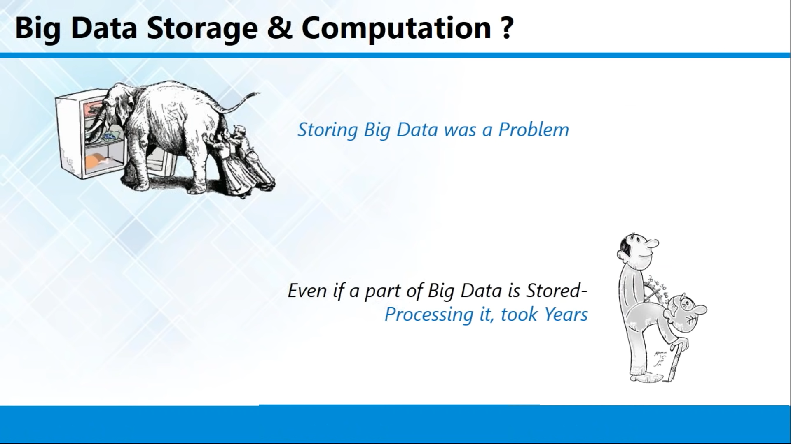

Slide 5
HDFS
1 file that will be of 2 TB storage

Slide 6
File System
Fat
Fat32
Ntfs
Ext1
Ext2
Ext3
Ext4
Oracle file system

Slide 7
HDFS Introduction
HDFS
Because of some limitations that will be avail on each and every file system by means of minimum and maximum volume it will support, minimum and maximum file size it will support , platform dependencies will be there.
To overcome with all those difficulties and with some extra features to handle the large volume of data Hadoop came up with some filesystem called as Hadoop Distributed file system that will only used in Hadoop framework.

Slide 8
MAP REDUCE
Logical unit of Separate computing and storage point
10 TB of Storage(HDFS)
800 Core Processor and 400 GB of ram(MAPREDUCE)
8 core processor
4 GB of RAM
100 GB of HD

Slide 9
MAP REDUCE
Mapreduce is nothing data processing model in Hadoop frame work
It a logical combination of CPU and RAM
If in the case of handle the Hadoop frame work data's this computational unit will act as processing model and it will complete the work as early as possible with the help of logical unit.

Slide 10
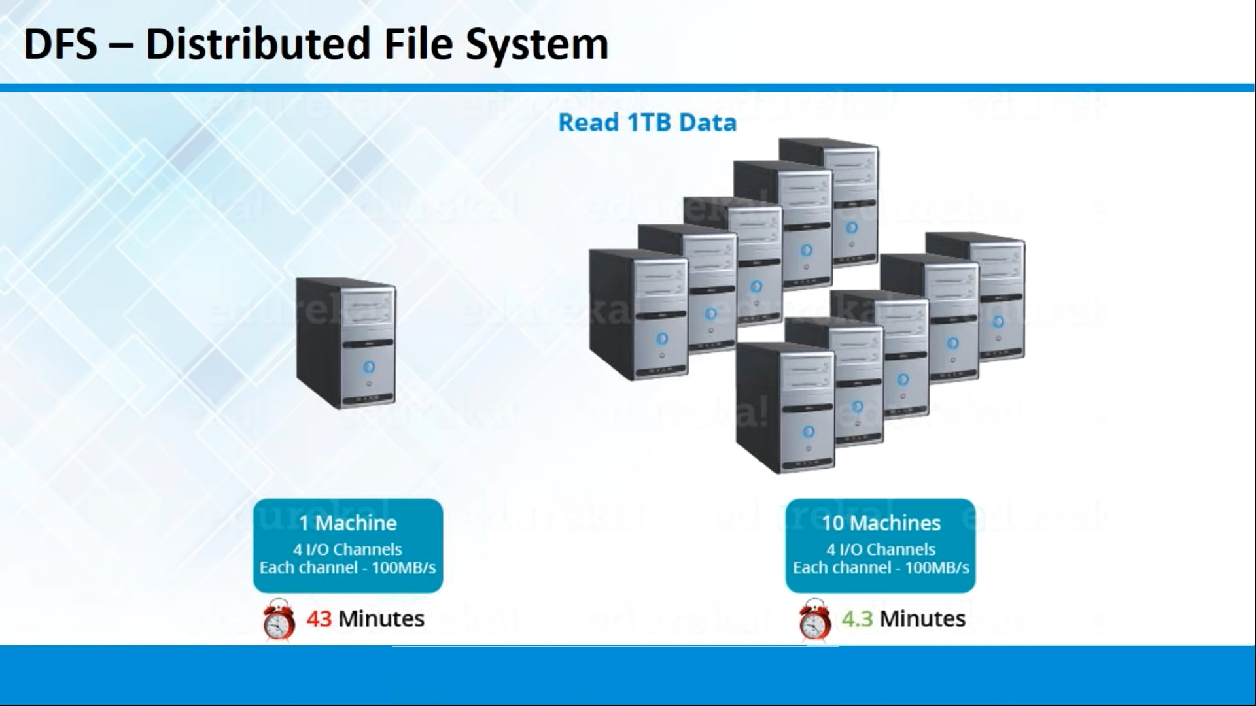

Slide 11
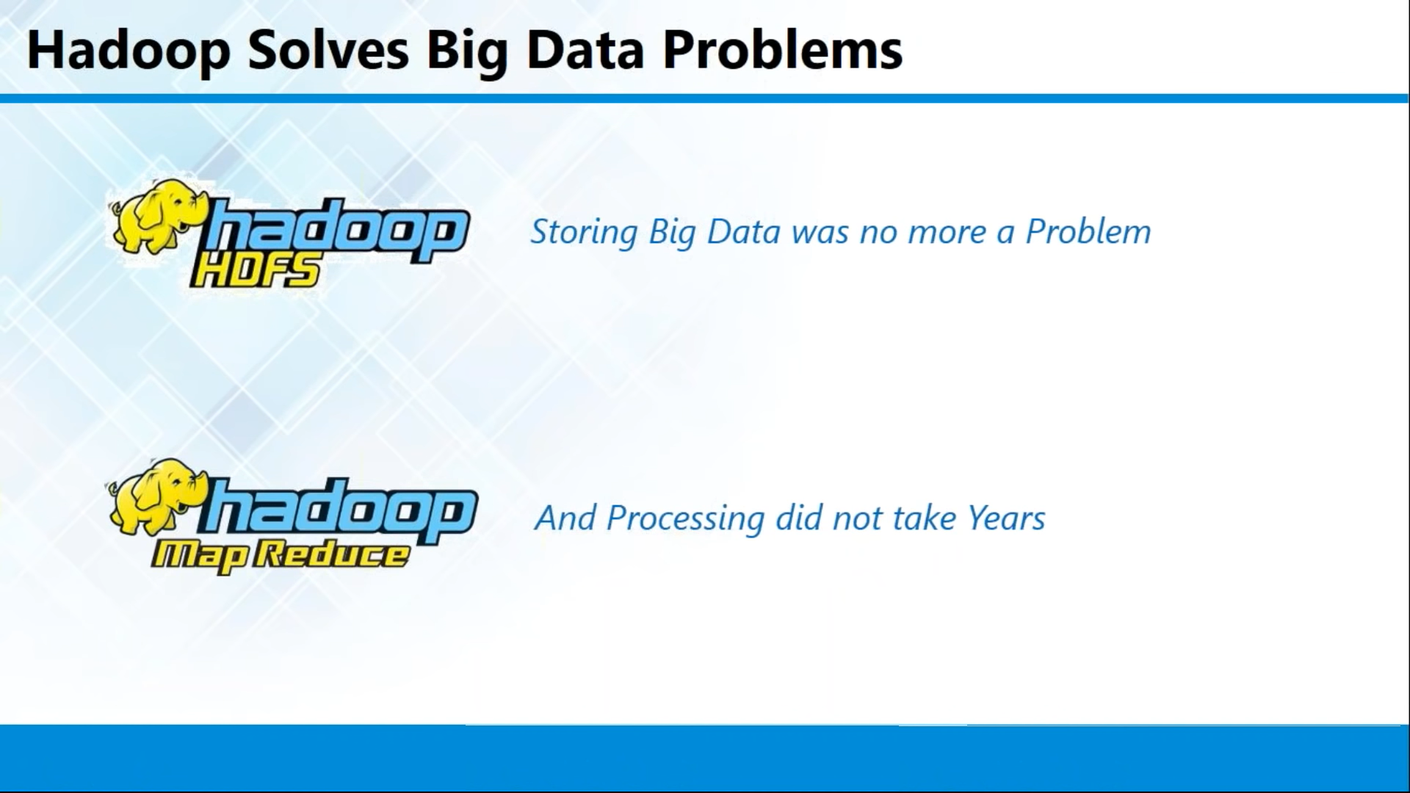

Slide 12
Hadoop Components
Hadoop Came up with 2 components
Storage(HDFS)
Processing(MAPREDUCE)

Slide 13
